Slide 1


Chapter 4
Network Layer:
The Data Plane
Computer Networking: A Top Down Approach
7th edition
Jim Kurose, Keith Ross
Pearson/Addison Wesley
April 2016
Homepage：http://scuvis.org
Email ：zhumin@scu.edu.cn
Phone ：13980020500
主讲：朱敏 / 助教：杨阳

Slide 2
Chapter 4: outline
4.1 Overview of Network layer
  data plane
  control plane
4.2 What’s inside a router
4.3 IP: Internet Protocol
  datagram format
  fragmentation
  IPv4 addressing
  network address translation
  IPv6
4.4 Generalized Forward and SDN
  match
  action
  OpenFlow examples of match-plus-action in action

Slide 3
Chapter 4: outline
4.1 Overview of Network layer
  data plane
  control plane
4.2 What’s inside a router
4.3 IP: Internet Protocol
  datagram format
  fragmentation
  IPv4 addressing
  network address translation
  IPv6
4.4 Generalized Forward and SDN
  match
  action
  OpenFlow examples of match-plus-action in action

Slide 4
Chapter 4: network layer
chapter goals:
understand principles behind network layer services, focusing on data plane:
  network layer service models
  forwarding versus routing
  how a router works
  generalized forwarding
instantiation, implementation in the Internet

Slide 5

Network layer
transport segment from sending to receiving host
on sending side encapsulates segments into datagrams
on rcving side, delivers segments to transport layer
network layer protocols in every host, router
router examines header fields in all IP datagrams passing through it
application
transport
network
data link
physical
network
data link
physical
network
data link
physical
network
data link
physical
network
data link
physical
network
data link
physical
network
data link
physical
network
data link
physical
network
data link
physical
network
data link
physical
application
transport
network
data link
physical
network
data link
physical
network
data link
physical

Slide 6
















Network layer
application
transport
network
data link
physical
transport segment from sending to receiving host
on sending side encapsulates segments into datagrams
on receiving side, delivers segments to transport layer
network layer protocols in every host, router
router examines header fields in all IP datagrams passing through it
network
data link
physical
network
data link
physical
network
data link
physical
network
data link
physical
network
data link
physical
network
data link
physical
network
data link
physical
network
data link
physical
network
data link
physical
application
transport
network
data link
physical
network
data link
physical
network
data link
physical

Slide 7


Creating a network app
回顾应用层
application
transport
network
data link
physical
write programs that:
run on (different) end systems
communicate over network
e.g., web server software communicates with browser software
no need to write software for network-core devices
network-core devices do not run user applications
applications on end systems allows for rapid app development, propagation
application
transport
network
data link
physical
application
transport
network
data link
physical

Slide 8


Transport services and protocols
回顾传输层
provide logical communication between app processes running on different hosts
transport protocols run in end systems
  send side: breaks app messages into segments, passes to network layer
  rcv side: reassembles segments into messages, passes to app layer
more than one transport protocol available to apps
  Internet: TCP and UDP
application
transport
network
data link
physical
logical end-end transport
application
transport
network
data link
physical

Slide 9
网络层服务概述
对比网络层
主机A
主机B
应用层
应用层
传输层
路由器
路由器
传输层
网络层
网络层
网络层
网络层
接口层
接口层
接口层
接口层
接口层
接口层
接口层通常包括数据链路层和物理层

Slide 10
Two Key Network-Layer Functions
forwarding: move packets from router’s input to appropriate router output
routing: determine route taken by packets from source to dest.
  routing algorithms
analogy:
routing: process of planning trip from source to dest
forwarding: process of getting through single interchange

Slide 11
Interplay between routing and forwarding
routing algorithm
local forwarding table
header value
output link
0100
0101
0111
1001
3
2
2
1
value in arriving
packet’s header
0111
1
3
2
MOOC-4.1 2:03-6:20

Slide 12
Network layer: data plane, control plane
Data plane
local, per-router function
determines how datagram arriving on router input port is forwarded to router output port
forwarding function
Control plane
network-wide logic
determines how datagram is routed among routers along end-end path from source host to destination host
two control-plane approaches:
  traditional routing algorithms: implemented in routers
  software-defined networking (SDN): implemented in (remote) servers
values in arriving
packet header
0111
1
3
2
V7 新增内容

Slide 13

Per-router control plane
Individual routing algorithm components in each and every router interact in the control plane
Routing
Algorithm
control
plane
data
plane
values in arriving
packet header
0111
1
3
2
V7 新增内容

Slide 14
Logically centralized control plane
A distinct (typically remote) controller interacts with local control agents (CAs)
Remote Controller
control
plane
data
plane
CA
CA
CA
CA
CA
values in arriving
packet header
0111
1
3
2
V7 新增内容

Slide 15
Connection setup
3rd important function in some network architectures:
  ATM, frame relay, X.25
before datagrams flow, two end hosts and intervening routers establish virtual connection
  routers get involved
network vs transport layer connection service:
  network: between two hosts (may also involve intervening routers in case of VCs)
  transport: between two processes

Slide 16
Network service model
Q: What service model for “channel” transporting datagrams from sender to receiver?
example services for individual datagrams:
guaranteed delivery
guaranteed delivery with less than 40 msec delay
example services for a flow of datagrams:
in-order datagram delivery
guaranteed minimum bandwidth to flow
restrictions on changes in inter-packet spacing

Slide 17
Network layer service models:
Network
Architecture
Internet
ATM
ATM
ATM
ATM
Service
Model
best effort
CBR
VBR
ABR
UBR
Guarantees ?
Congestion
feedback
no (inferred
via loss)
no
congestion
no
congestion
yes
no
Bandwidth
none
constant
rate
guaranteed
rate
guaranteed
minimum
none
Loss
no
yes
yes
no
no
Order
no
yes
yes
yes
yes
Timing
no
yes
yes
no
no
UBR（Unspecified Bit Rate）未指定比特速率； VBR（Variable Bitrate）动态比特率
ABR（Average Bitrate）平均比特率； CBR（Constants Bit Rate）固定码率

Slide 18
Chapter 4: Network Layer
4. 1 Introduction
4.2 Virtual circuit and datagram networks
4.3 What’s inside a router
4.4 IP: Internet Protocol
  Datagram format
  IPv4 addressing
  ICMP
  IPv6
4.5 Routing algorithms
  Link state
  Distance Vector
  Hierarchical routing
4.6 Routing in the Internet
  RIP
  OSPF
  BGP
4.7 Broadcast and multicast routing

Slide 19
Network layer connection and connection-less service
A router, in fact, is a switch that creates a connection between an input port and an output port (or a set of output ports), just as an electrical switch connects the input to the output to let electricity flow.
Datagram Approach
Virtual-Circuit Approach
MOOC-4.2.1 2:10-8:50

Slide 20
Network layer connection and connection-less service
datagram network provides network-layer connectionless service
VC network provides network-layer connection service
analogous to the transport-layer services, but:
  service: host-to-host
  no choice: network provides one or the other
  implementation: in network core

Slide 21
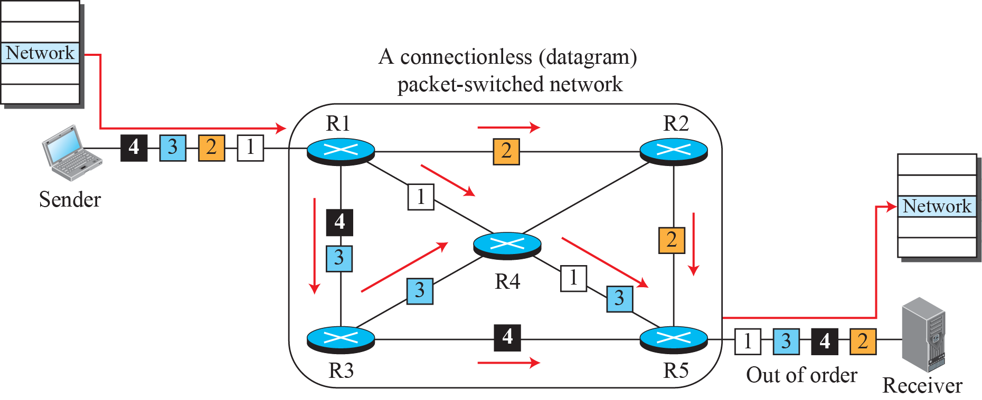
A connectionless packet-switched network

Slide 22
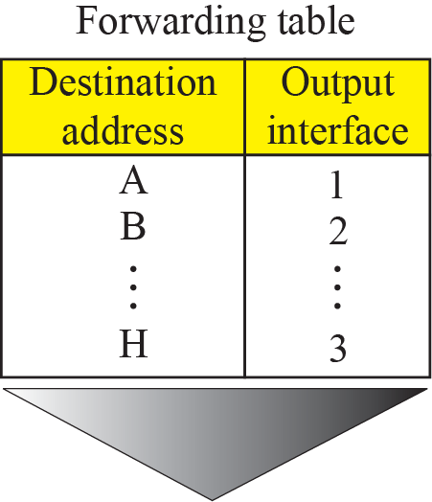
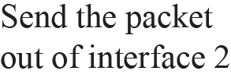
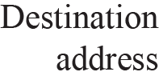
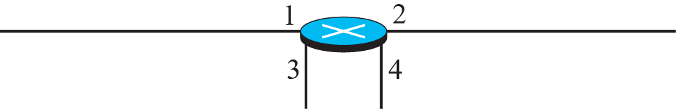
Forwarding process in a router
when used in a connectionless network

Slide 23
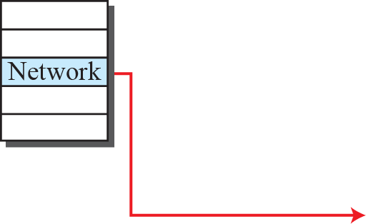
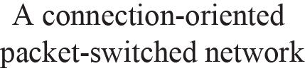
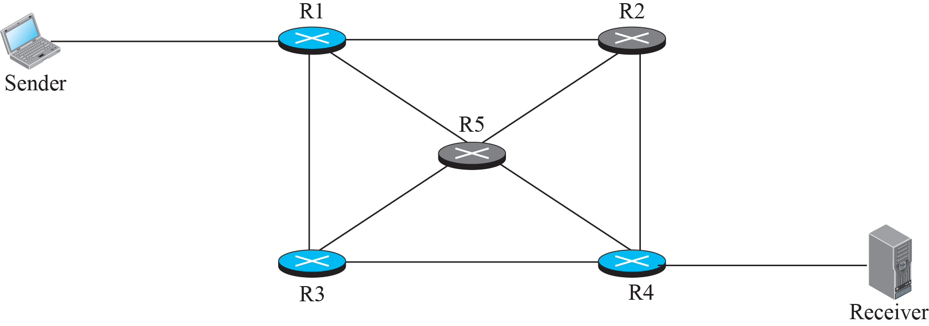


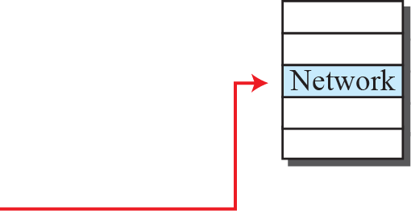
A virtual-circuit packet-switched network

Slide 24
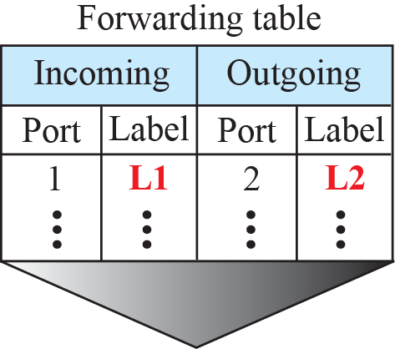


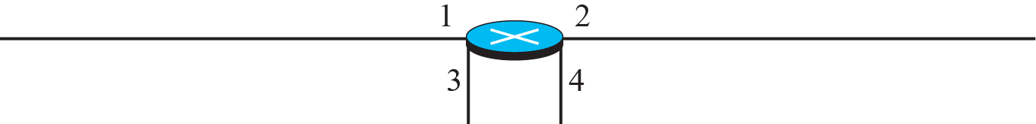
Forwarding process in a router
when used in a virtual circuit network

Slide 25
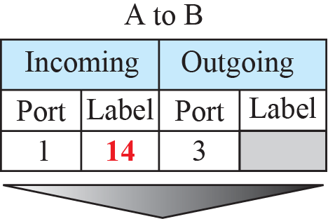
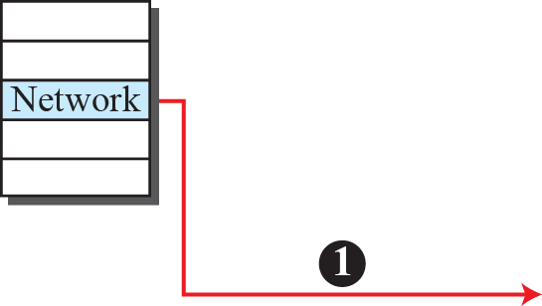
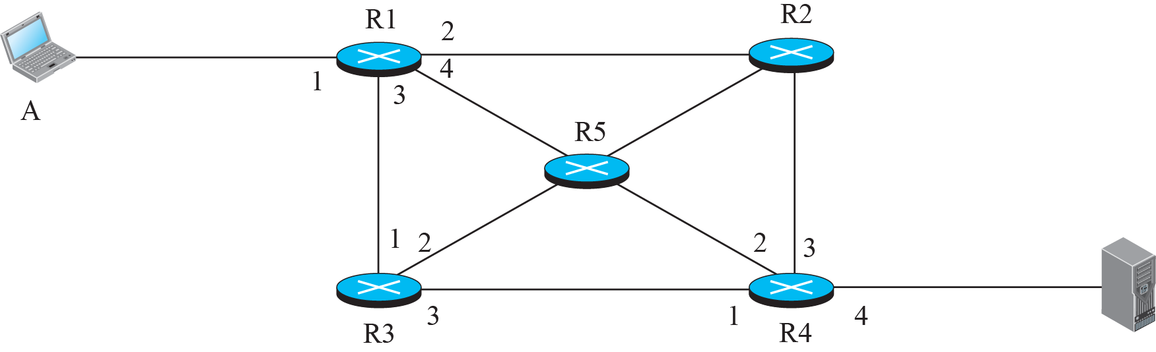
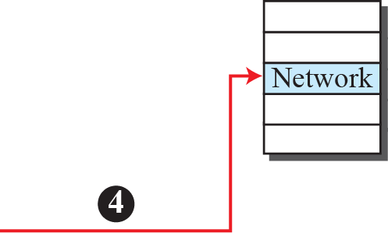


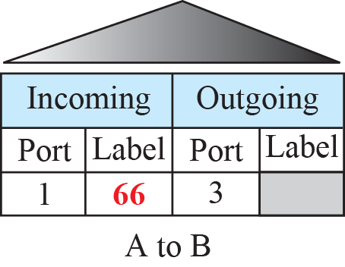
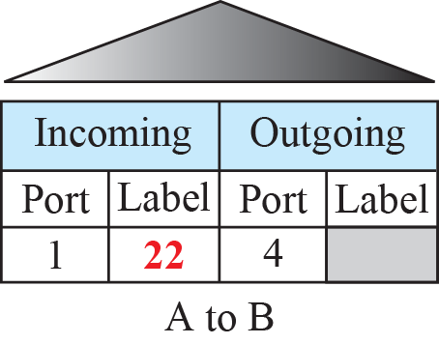
Sending request packet in a virtual-circuit network

Slide 26
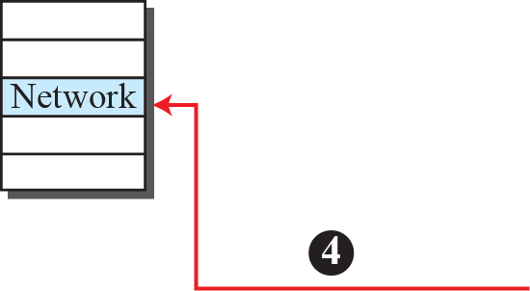
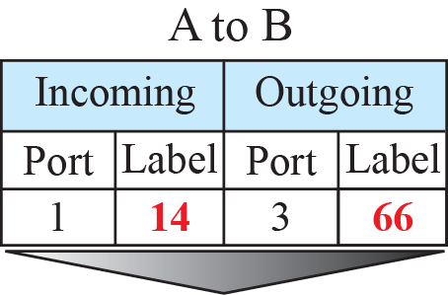

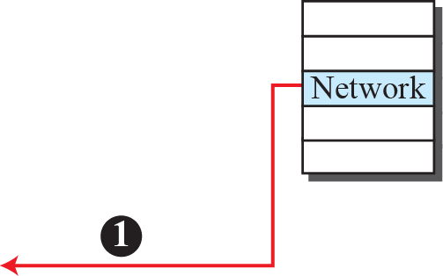





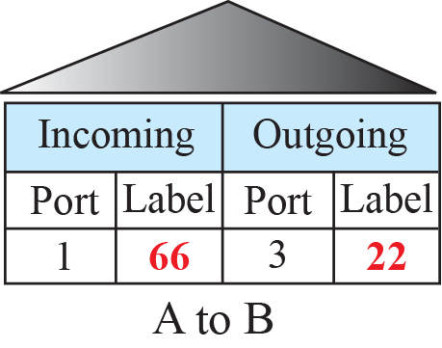
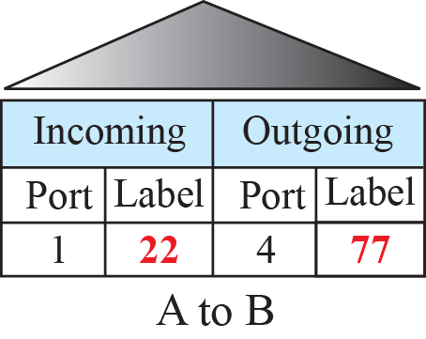
Sending acknowledgments in a virtual-circuit network

Slide 27
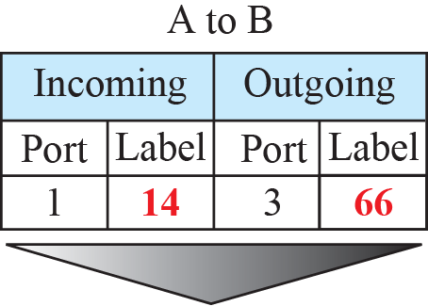
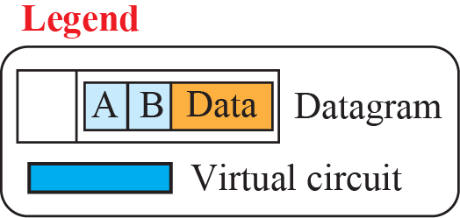
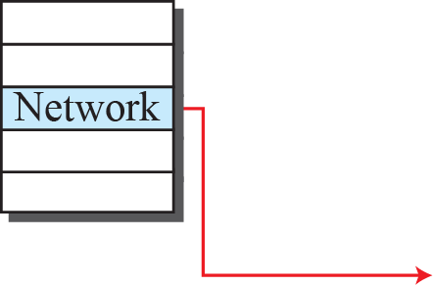

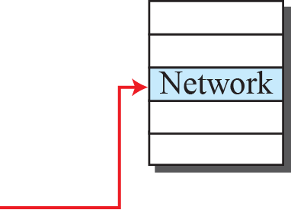



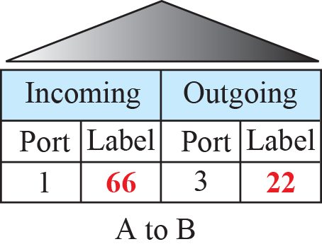
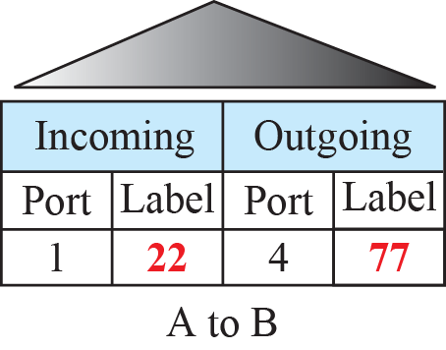
Sending datagram in a virtual-circuit network

Slide 28
Virtual circuits
“source-to-dest path behaves much like telephone circuit”
  performance-wise
  network actions along source-to-dest path
call setup, teardown for each call before data can flow
each packet carries VC identifier (not destination host address)
every router on source-dest path maintains “state” for each passing connection
link, router resources (bandwidth, buffers) may be allocated to VC (dedicated resources = predictable service)

Slide 29
VC implementation
a VC consists of:
  path from source to destination
  VC numbers, one number for each link along path
  entries in forwarding tables in routers along path
packet belonging to VC carries VC number (rather than dest address)
VC number can be changed on each link.
  New VC number comes from forwarding table

Slide 30
VC Forwarding table
视频：14’10”
VC number
12
22
32
1
3
2
Forwarding table in
northwest router:
interface
number
Incoming interface Incoming VC # Outgoing interface Outgoing VC #
1 12 3 22
2 63 1 18
3 7 2 17
1 97 3 87
… … … …
Routers maintain connection state information!

Slide 31
Virtual circuits: signaling protocols
used to setup, maintain, teardown VC
used in ATM, frame-relay, X.25
not used in today’s Internet
application
transport
network
data link
physical
5. Data flow begins
6. Receive data
application
transport
network
data link
physical
4. Call connected
3. Accept call
1. Initiate call
2. incoming call

Slide 32
Datagram networks
no call setup at network layer
routers: no state about end-to-end connections
  no network-level concept of “connection”
packets forwarded using destination host address
  packets between same source-dest pair may take different paths
application
transport
network
data link
physical
application
transport
network
data link
physical
1. Send data
2. Receive data
MOOC-4.2.2 3:00-17:10

Slide 33
Datagram or VC network: why?
Internet (datagram)
data exchange among computers
  “elastic” service, no strict timing req.
“smart” end systems (computers)
  can adapt, perform control, error recovery
  simple inside network, complexity at “edge”
many link types
  different characteristics
  uniform service difficult
ATM (VC)
evolved from telephony
human conversation:
  strict timing, reliability requirements
  need for guaranteed service
“dumb” end systems
  telephones
  complexity inside network
MOOC-4.2.2 17:28起

Slide 34
Datagram Forwarding table
视频：6’10”
routing algorithm
4 billion IP addresses, so rather than list individual destination address
list range of addresses
(aggregate table entries)
local forwarding table
dest address
output link
address-range 1
address-range 2
address-range 3
address-range 4
3
2
2
1
IP destination address in
arriving packet’s header
1
3
2
2025.11.12讲到此页

Slide 35
Datagram Forwarding table
Destination Address Range
11001000 00010111 00010000 00000000
through
11001000 00010111 00010111 11111111
11001000 00010111 00011000 00000000
through
11001000 00010111 00011000 11111111
11001000 00010111 00011001 00000000
through
11001000 00010111 00011111 11111111
otherwise
Link Interface
0
1
2
3
Q: but what happens if ranges don’t divide up so nicely?

Slide 36
Longest prefix matching (lpm)
Longest prefix matching
when looking for forwarding table entry for given destination address, use longest address prefix that matches destination address.
Destination Address Range
11001000 00010111 00010*** *********
11001000 00010111 00011000 *********
11001000 00010111 00011*** *********
otherwise
Link interface
0
1
2
3
Examples:
DA: 11001000 00010111 00010110 10100001
Which interface?
0
DA: 11001000 00010111 00011000 10101010
Which interface?
1/2

Slide 37
Chapter 4: outline
4.1 Overview of Network layer
  data plane
  control plane
4.2 What’s inside a router
4.3 IP: Internet Protocol
  datagram format
  fragmentation
  IPv4 addressing
  network address translation
  IPv6
4.4 Generalized Forward and SDN
  match
  action
  OpenFlow examples of match-plus-action in action

Slide 38
Router architecture overview
high-level view of generic(通用) router architecture:
routing, management
control plane (software)
operates in millisecond
time frame
routing
processor
forwarding data plane (hardware) operttes in nanosecond timeframe
high-seed
switching
fabric
router input ports
router output ports

Slide 39
Input port functions
lookup,
forwarding
queueing
line
termination
link
layer
protocol
(receive)
switch
fabric
physical layer:
bit-level reception
data link layer:
e.g., Ethernet
see chapter 5
decentralized switching:
using header field values, lookup output port using forwarding table in input port memory (“match plus action”)
goal: complete input port processing at ‘line speed’
queuing: if datagrams arrive faster than forwarding rate into switch fabric

Slide 40
Input port functions
lookup,
forwarding
queueing
line
termination
link
layer
protocol
(receive)
switch
fabric
physical layer:
bit-level reception
decentralized switching:
using header field values, lookup output port using forwarding table in input port memory (“match plus action”)
destination-based forwarding: forward based only on destination IP address (traditional)
generalized forwarding: forward based on any set of header field values
data link layer:
e.g., Ethernet
see chapter 5

Slide 41
Destination-based forwarding
forwarding table
Destination Address Range
11001000 00010111 00010000 00000000
through
11001000 00010111 00010111 11111111
11001000 00010111 00011000 00000000
through
11001000 00010111 00011000 11111111
11001000 00010111 00011001 00000000
through
11001000 00010111 00011111 11111111
otherwise
Link Interface
0
1
2
3
Q: but what happens if ranges don’t divide up so nicely?

Slide 42
Longest prefix matching
longest prefix matching
when looking for forwarding table entry for given destination address, use longest address prefix that matches destination address.
Destination Address Range
11001000 00010111 00010*** *********
11001000 00010111 00011000 *********
11001000 00010111 00011*** *********
otherwise
Link interface
0
1
2
3
examples:
DA: 11001000 00010111 00010110 10100001
which interface?
DA: 11001000 00010111 00011000 10101010
which interface?

Slide 43
Longest prefix matching
we’ll see why longest prefix matching is used shortly, when we study addressing
longest prefix matching: often performed using ternary content addressable memories (TCAMs)
  content addressable: present address to TCAM: retrieve address in one clock cycle, regardless of table size
  Cisco Catalyst: can up ~1M routing table entries in TCAM
三态内容可寻址存储器

Slide 44
Switching fabrics
transfer packet from input buffer to appropriate output buffer
switching rate: rate at which packets can be transfer from inputs to outputs
  often measured as multiple of input/output line rate
  N inputs: switching rate N times line rate desirable
three types of switching fabrics
memory
memory
bus
crossbar

Slide 45
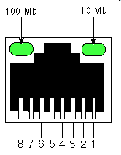
Switching via memory
first generation routers:
traditional computers with switching under direct control of CPU
packet copied to system’s memory
speed limited by memory bandwidth (2 bus crossings per datagram)
input
port
(e.g.,
Ethernet)
output
port
(e.g.,
Ethernet)
memory
system bus

Slide 46
Switching via a bus
datagram from input port memory to output port memory via a shared bus
bus contention: switching speed limited by bus bandwidth
32 Gbps bus, Cisco 5600: sufficient speed for access and enterprise routers
bus

Slide 47
Switching via interconnection network
overcome bus bandwidth limitations
banyan networks, crossbar, other interconnection nets initially developed to connect processors in multiprocessor
advanced design: fragmenting datagram into fixed length cells, switch cells through the fabric.
Cisco 12000: switches 60 Gbps through the interconnection network
crossbar

Slide 48
Input port queuing
fabric slower than input ports combined -> queueing may occur at input queues
  queueing delay and loss due to input buffer overflow!
Head-of-the-Line (HOL) blocking: queued datagram at front of queue prevents others in queue from moving forward
switch
fabric
switch
fabric
output port contention:
only one red datagram can be transferred.
lower red packet is blocked
one packet time later: green packet experiences HOL blocking

Slide 49
Output ports
This slide in HUGELY important!
datagram
buffer
queueing
switch
fabric
link
layer
protocol
(send)
line
termination
buffering required when datagrams arrive from fabric faster than the transmission rate
scheduling discipline chooses among queued datagrams for transmission
Datagram (packets) can be lost due to congestion, lack of buffers
Priority scheduling – who gets best performance, network neutrality

Slide 50
Output port queueing
switch
fabric
switch
fabric
at t, packets more
from input to output
one packet time later
buffering when arrival rate via switch exceeds output line speed
queueing (delay) and loss due to output port buffer overflow!

Slide 51
How much buffering?
RFC 3439 rule of thumb: average buffering equal to “typical” RTT (say 250 msec) times link capacity C
  e.g., C = 10 Gpbs link: 2.5 Gbit buffer
recent recommendation: with N flows, buffering equal to
.
RTT C
N

Slide 52
Scheduling mechanisms
scheduling: choose next packet to send on link
FIFO (first in first out) scheduling: send in order of arrival to queue
  real-world example?
  discard policy: if packet arrives to full queue: who to discard?
    tail drop: drop arriving packet
    priority: drop/remove on priority basis
    random: drop/remove randomly
packet
arrivals
packet
departures
queue
(waiting area)
link
(server)

Slide 53
Scheduling policies: priority
priority scheduling: send highest priority queued packet
multiple classes, with different priorities
  class may depend on marking or other header info, e.g. IP source/dest, port numbers, etc.
  real world example?
high priority queue
(waiting area)
arrivals
departures
classify
link
(server)
low priority queue
(waiting area)
2
1
3
4
5
arrivals
packet in service
1
3
2
4
5
departures
1
3
2
4
5

Slide 54
Scheduling policies: still more
Round Robin (RR) scheduling:
multiple classes
cyclically scan class queues, sending one complete packet from each class (if available)
real world example?
2
1
3
4
5
arrivals
packet in service
1
3
2
4
5
departures
1
3
3
4
5

Slide 55
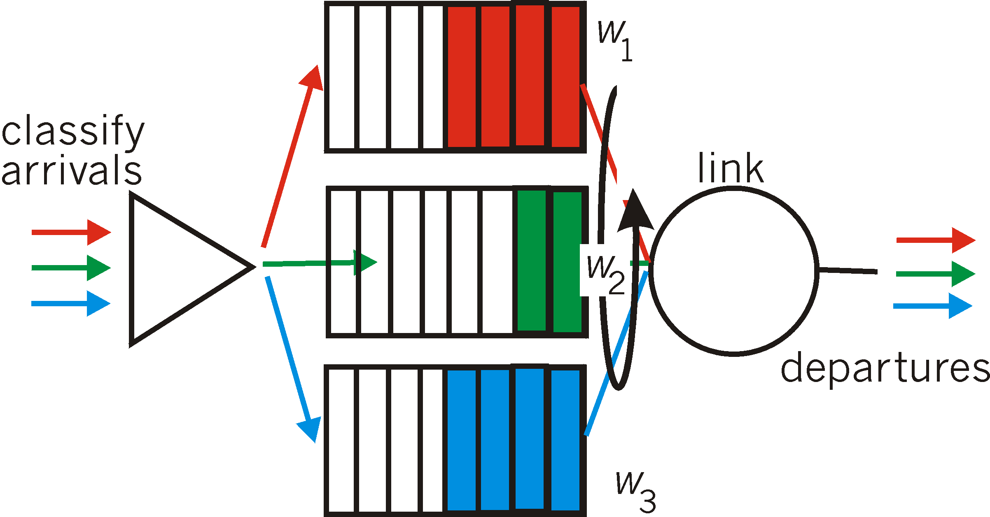
Scheduling policies: still more
Weighted Fair Queuing (WFQ):
generalized Round Robin
each class gets weighted amount of service in each cycle
real-world example?

Slide 56
Chapter 4: outline
4.1 Overview of Network layer
  data plane
  control plane
4.2 What’s inside a router
4.3 IP: Internet Protocol
  datagram format
  fragmentation
  IPv4 addressing
  network address translation
  IPv6
4.4 Generalized Forward and SDN
  match
  action
  OpenFlow examples of match-plus-action in action

Slide 57
The Internet network layer
host, router network layer functions:
transport layer: TCP, UDP
惯例、规约
routing protocols
path selection
RIP, OSPF, BGP
IP protocol
addressing conventions
datagram format
packet handling conventions
network
layer
forwarding
table
ICMP protocol
error reporting
router “signaling”
link layer
physical layer

Slide 58
IP datagram format
IP protocol version
number
32 bits
total datagram
length (bytes)
header length
(4bytes为单位)
head.
len
type of
service
ver
length
for
fragmentation/
reassembly
“type” of data
flgs
fragment
offset
16-bit identifier
max number
remaining hops
(decremented at
each router)
time to
live
upper
layer
header
checksum
每一跳重新计算
32 bit source IP address
upper layer protocol
to deliver payload to
32 bit destination IP address
options (if any)
e.g. timestamp,
record route
taken, specify
list of routers
to visit.
data
(variable length,
typically a TCP
or UDP segment)

Slide 59

IP fragmentation, reassembly
network links have MTU (max.transfer size) - largest possible link-level frame
  different link types, different MTUs
large IP datagram divided (“fragmented”) within net
  one datagram becomes several datagrams
  “reassembled” only at final destination
  IP header bits used to identify, order related fragments
fragmentation:
in: one large datagram
out: 3 smaller datagrams
…
reassembly
…

Slide 60
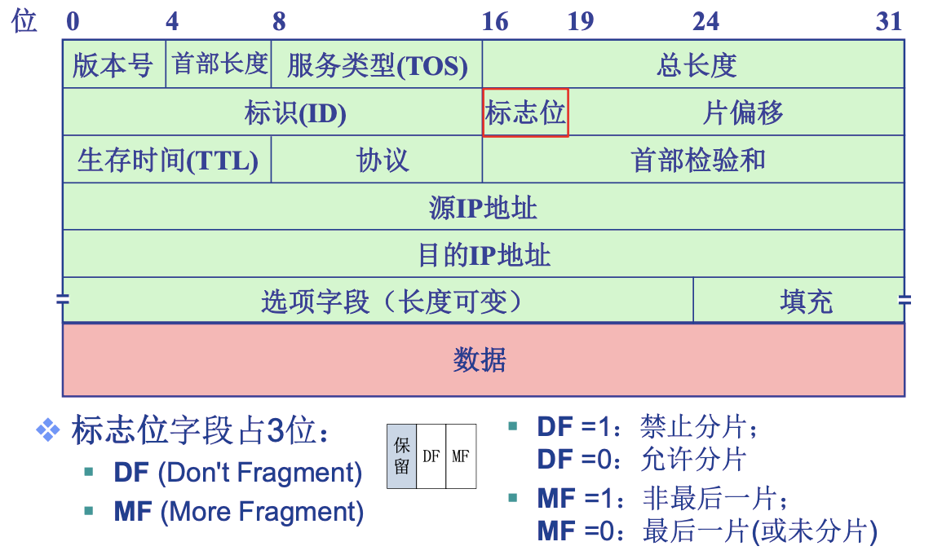
IP fragmentation, reassembly

Slide 61
IP fragmentation, reassembly
length
=4000
ID
=x
fragflag
=0
offset
=0
example:
4000 byte datagram
(20H+3980D)
MTU = 1500 bytes
one large datagram becomes
several smaller datagrams
1480 bytes in
data field
length
=1500
ID
=x
fragflag
=1
offset
=0
offset =
1480/8
length
=1500
ID
=x
fragflag
=1
offset
=185
length
=1040
ID
=x
fragflag
=0
offset
=370
这些数值如何计算得到？
MOOC 4.3.2 6:10

Slide 62
Chapter 4: outline
4.1 Overview of Network layer
  data plane
  control plane
4.2 What’s inside a router
4.3 IP: Internet Protocol
  datagram format
  fragmentation
  IPv4 addressing
  network address translation
  IPv6
4.4 Generalized Forward and SDN
  match
  action
  OpenFlow examples of match-plus-action in action

Slide 63
IP addressing: introduction
223.1.1.1
IP address: 32-bit identifier for host, router interface
interface: connection between host/router and physical link
  router’s typically have multiple interfaces
  host typically has one or two interfaces (e.g., wired Ethernet, wireless 802.11)
IP addresses associated with each interface
223.1.2.1
223.1.1.2
223.1.1.4
223.1.2.9
223.1.1.3
223.1.3.27
223.1.2.2
223.1.3.1
223.1.3.2
223.1.1.1 = 11011111 00000001 00000001 00000001
223
1
1
1

Slide 64

IP addressing: introduction
223.1.1.1
Q: how are interfaces actually connected?
A: we’ll learn about that in chapter 5, 6.
223.1.2.1
223.1.1.2
223.1.1.4
223.1.2.9
223.1.1.3
223.1.3.27
223.1.2.2
A: wired Ethernet interfaces connected by Ethernet switches
223.1.3.1
223.1.3.2
For now: don’t need to worry about how one interface is connected to another (with no intervening router)
A: wireless WiFi interfaces connected by WiFi base station

Slide 65
Subnets
IP address:
  subnet part - high order bits
  host part - low order bits
what’s a subnet ?
  device interfaces with same subnet part of IP address
  can physically reach each other without intervening router
223.1.1.1
223.1.1.2
223.1.2.1
223.1.1.4
223.1.2.9
223.1.2.2
223.1.1.3
223.1.3.27
subnet
223.1.3.1
223.1.3.2
network consisting of 3 subnets
不跨越路由器

Slide 66
Subnets
223.1.1.0/24
223.1.2.0/24
recipe
to determine the subnets, detach each interface from its host or router, creating islands of isolated networks
each isolated network is called a subnet
223.1.1.1
223.1.1.2
223.1.2.1
223.1.1.4
223.1.2.9
223.1.2.2
223.1.1.3
223.1.3.27
subnet
223.1.3.1
223.1.3.2
223.1.3.0/24
subnet mask: /24

Slide 67
Subnets
223.1.1.2
how many?
223.1.1.1
223.1.1.4
223.1.1.3
223.1.9.2
223.1.7.0
223.1.9.1
223.1.7.1
223.1.8.1
223.1.8.0
223.1.2.6
223.1.3.27
223.1.2.1
223.1.2.2
223.1.3.1
223.1.3.2

Slide 68
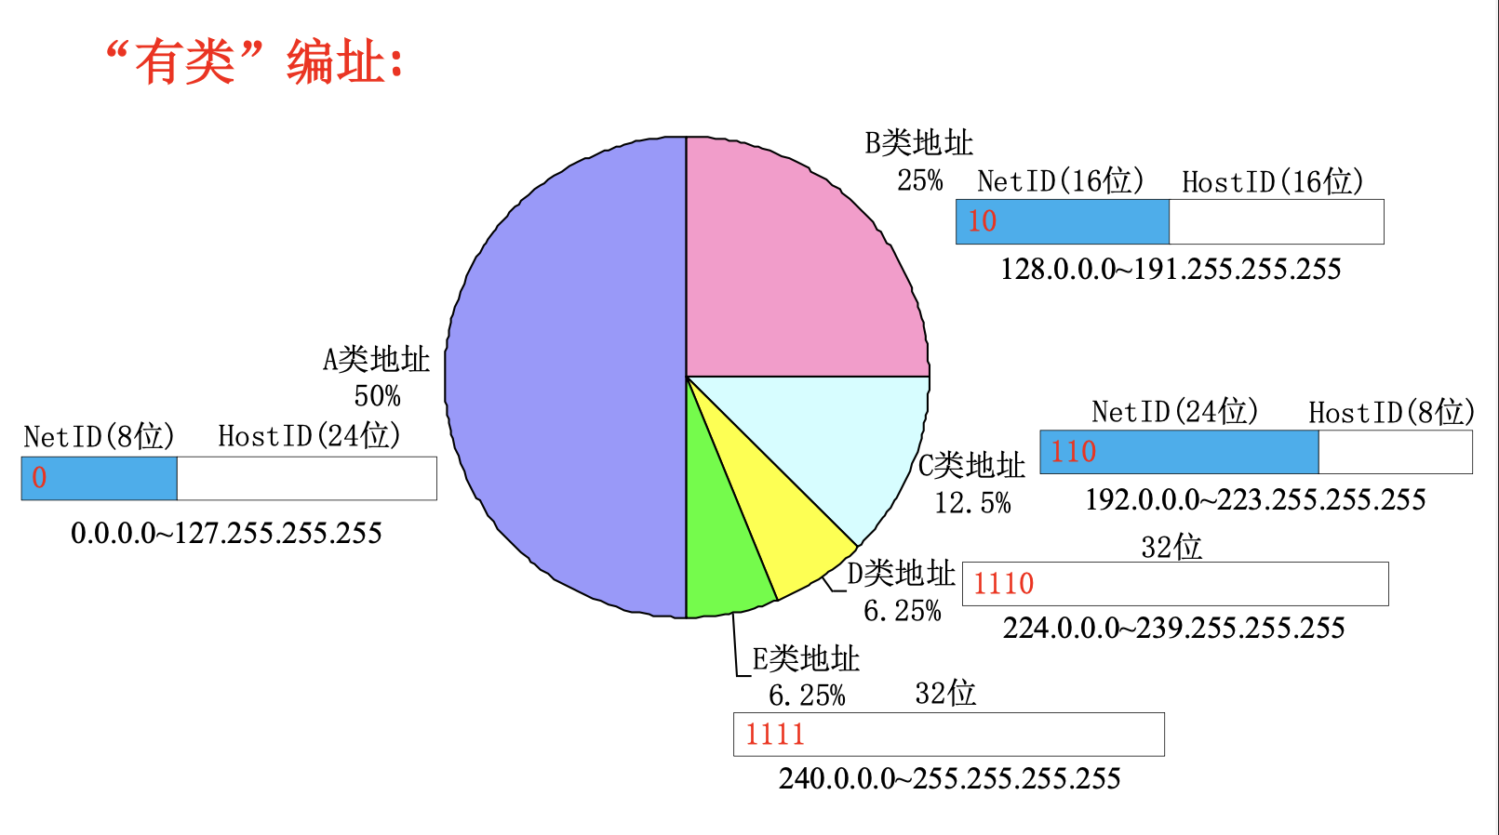
有类IP地址（补充）
0
8
16
24
31
0
A
netid
Hostid
The number of hosts is 2²⁴.address:1.0.0.0~127.255.255.255
1
0
B
netid
Hostid
The number of hosts is 2¹⁶.address:128.0.0.0~191.255.255.255
1
1
0
C
netid
Hostid
The number of hosts is 2⁸.address:192.0.0.0~223.255.255.255
Multicast(多点广播)
1
1
1
0
D
address:224.0.0.0~239.255.255.255
Preserved for future use
1
1
1
1
0
E
address:240.0.0.0~247.255.255.255
MOOC-4.3.4 有类IP地址

Slide 69
有类IP地址（补充）
1. broadcast address(广播地址):主机号全为1.向其它网络广播,必须有一个有效的网络号。
2. limited broadcast address (有限广播):255.255.255.255,向本网络的所有主机广播，不需要网络号
3.“0” address(“0”地址):0.0.0.0。本网络本主机
4. loopback address (回送地址):netid=127，将信息回送本机。

Slide 70
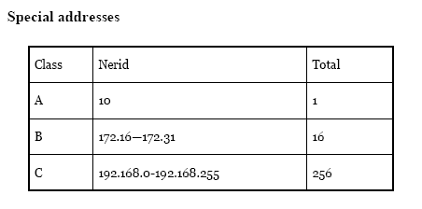
有类IP地址（补充）

Slide 71
关于子网划分
MOOC 4.3.5 大约20分钟
谢希仁配套PPT

Slide 72
三级 IP 地址
从 1985 年起在 IP 地址中又增加了一个“子网号字段”，使两级的 IP 地址变成为三级的 IP 地址。
这种做法叫做划分子网 (subnetting) 。
划分子网已成为互联网的正式标准协议。

Slide 73
划分子网的基本思路
划分子网纯属一个单位内部的事情。单位对外仍然表现为没有划分子网的网络。
从主机号借用若干个位作为子网号 subnet-id，而主机号 host-id 也就相应减少了若干个位。
本地地址
网络号
子网号
主机号
32 位
IP地址 ::= {<网络号>, <子网号>, <主机号>} (4-2)

Slide 74
划分子网的基本思路（续）
凡是从其他网络发送给本单位某个主机的 IP 数据报，仍然是根据 IP 数据报的目的网络号 net-id，先找到连接在本单位网络上的路由器。
然后此路由器在收到 IP 数据报后，再按目的网络号 net-id 和子网号 subnet-id 找到目的子网。
最后就将 IP 数据报直接交付目的主机。

Slide 75
一个未划分子网的 B 类网络145.13.0.0
我的网络地址
是 145.13.0.0
145.13.3.11
145.13.3.101
…
145.13.7.34
R₂
145.13.3.10
145.13.7.35
R₁
网络
145.13.0.0
…
R₃
145.13.7.56
…
所有到网络 145.13.0.0的分组均到达此路由器
145.13.21.23
145.13.21.8
145.13.21.9

Slide 76
划分为三个子网后对外仍是一个网络
所有到达网络145.13.0.0 的分组均到达此路由器
145.13.3.11
145.13.3.101
145.13.7.34
145.13.3.10
…
145.13.7.35
R₂
子网 145.13.3.0
子网
145.13.7.0
…
R₁
145.13.7.56
R₃
子网 145.13.21.0
…
145.13.21.23
145.13.21.9
网络
145.13.0.0
145.13.21.8

Slide 77
划分子网后变成了三级结构
当没有划分子网时，IP 地址是两级结构。
划分子网后 IP 地址就变成了三级结构。
划分子网只是把 IP 地址的主机号 host-id 这部分进行再划分，而不改变 IP 地址原来的网络号 net-id。
本地地址
网络号
子网号
主机号
32 位

Slide 78
划分子网后变成了三级结构
优点
  减少了 IP 地址的浪费
  使网络的组织更加灵活
  更便于维护和管理
划分子网纯属一个单位内部的事情，对外部网络透明，对外仍然表现为没有划分子网的一个网络。
Q：如何知道是否划分了子网？利用多少位划分子网？

Slide 79
子网掩码
从一个 IP 数据报的首部并无法判断源主机或目的主机所连接的网络是否进行了子网划分。
使用子网掩码 (subnet mask) 可以找出 IP 地址中的子网部分。
规则：
子网掩码长度 ＝ 32 位
某位 ＝ 1：IP地址中的对应位为网络号和子网号
某位 ＝ 0：IP地址中的对应位为主机号

Slide 80
IP 地址的各字段和子网掩码
网络号
主机号
两级 IP 地址
145 . 13 .
3 . 10
网络号
子网号
主机号
三级 IP 地址
145 . 13 .
3 . 10
子网号为 3 的网络的网络号
主机号
三级 IP 地址
的子网掩码
1 1 1 1 1 1 1 1 1 1 1 1 1 1 1 1 1 1 1 1 1 1 1 1
0 0 0 0 0 0 0 0
子网的
网络地址
145 . 13 . 3
0

Slide 81
(IP 地址) AND (子网掩码) =网络地址
两级 IP 地址
网络号
主机号
三级 IP 地址
网络号
子网号
主机号
逐位进行 AND 运算
网络号
子网号
主机号
三级 IP 地址
的子网掩码
1 1 1 1 1 1 1 1 1 1 1 1 1 1 1 1 1 1 1 1 1 1 1 1
0 0 0 0 0 0 0 0
子网的
网络地址
网络号
子网号
0

Slide 82
默认子网掩码
A
类
地
址
网络地址
网络号
主机号为全 0
默认子网掩码
255.0.0.0
1 1 1 1 1 1 1 1
0 0 0 0 0 0 0 0 0 0 0 0 0 0 0 0 0 0 0 0 0 0 0 0
B
类
地
址
网络地址
网络号
主机号为全 0
默认子网掩码
255.255.0.0
1 1 1 1 1 1 1 1 1 1 1 1 1 1 1 1
0 0 0 0 0 0 0 0 0 0 0 0 0 0 0 0
C
类
地
址
网络地址
网络号
主机号为全 0
默认子网掩码
255.255.255.0
1 1 1 1 1 1 1 1 1 1 1 1 1 1 1 1 1 1 1 1 1 1 1 1
0 0 0 0 0 0 0 0

Slide 83
子网掩码是一个重要属性
子网掩码是一个网络或一个子网的重要属性。
路由器在和相邻路由器交换路由信息时，必须把自己所在网络（或子网）的子网掩码告诉相邻路由器。
路由器的路由表中的每一个项目，除了要给出目的网络地址外，还必须同时给出该网络的子网掩码。
若一个路由器连接在两个子网上就拥有两个网络地址和两个子网掩码。

Slide 84
子网划分方法
有固定长度子网和变长子网两种子网划分方法。
在采用固定长度子网时，所划分的所有子网的子网掩码都是相同的。
虽然根据已成为互联网标准协议的 RFC 950 文档，子网号不能为全 1 或全 0，但随着无分类域间路由选择 CIDR 的广泛使用，现在全 1 和全 0 的子网号也可以使用了，但一定要谨慎使用，确认你的路由器所用的路由选择软件是否支持全 0 或全 1 的子网号这种较新的用法。
划分子网增加了灵活性，但却减少了能够连接在网络上的主机总数。

Slide 85
B 类地址的子网划分选择（使用固定长度子网）
子网号的位数 | 子网掩码 | 子网数 | 每个子网的主机数
2 | 255.255.192.0 | 2 | 16382
3 | 255.255.224.0 | 6 | 8190
4 | 255.255.240.0 | 14 | 4094
5 | 255.255.248.0 | 30 | 2046
6 | 255.255.252.0 | 62 | 1022
7 | 255.255.254.0 | 126 | 510
8 | 255.255.255.0 | 254 | 254
9 | 255.255.255.128 | 510 | 126
10 | 255.255.255.192 | 1022 | 62
11 | 255.255.255.224 | 2046 | 30
12 | 255.255.255.240 | 4094 | 14
13 | 255.255.255.248 | 8190 | 6
14 | 255.255.255.252 | 16382 | 2
表中的“子网号的位数”中没有 0, 1, 15 和 16 这四种情况，因为这没有意义。

Slide 86
【例4-2】已知 IP 地址是 141.14.72.24，子网掩码是 255.255.192.0。试求网络地址。
(a) 点分十进制表示的 IP 地址
141 . 14 .
72 . 24
(b) IP 地址的第 3 字节是二进制
141 . 14 .
0 1 0 0 1 0 0 0
. 24
(c) 子网掩码是 255.255.192.0
1 1 1 1 1 1 1 1 1 1 1 1 1 1 1 1 1 1 0 0 0 0 0 0
0 0 0 0 0 0 0 0
(d) IP 地址与子网掩码逐位相与
141 . 14 . 0 1 0 0 0 0 0 0
. 0
(e) 网络地址（点分十进制表示）
141 . 14 .
64 . 0

Slide 87
【例4-3】上例中，若子网掩码改为 255.255.224.0，试求网络地址，讨论所得结果。
(a) 点分十进制表示的 IP 地址
141 . 14 .
72 . 24
(b) IP 地址的第 3 字节是二进制
141 . 14 .
0 1 0 0 1 0 0 0
. 24
(c) 子网掩码是 255.255.224.0
1 1 1 1 1 1 1 1 1 1 1 1 1 1 1 1 1 1 1 0 0 0 0 0
0 0 0 0 0 0 0 0
(d) IP 地址与子网掩码逐位相与
141 . 14 . 0 1 0 0 0 0 0 0
. . 0
(e) 网络地址（点分十进制表示）
141 . 14 .
64 . 0
不同的子网掩码得出相同的网络地址。
但不同的掩码的效果是不同的。

Slide 88

子网划分举例
MOOC 4.3.5 大约11’10”处
子网201.2.3.0，255.255.255.0， 划分为等长的4个子网
201.2.3.0
255.255.255.192
201.2.3.64
255.255.255.192
201.2.3.192
255.255.255.192
201.2.3.128
255.255.255.192

Slide 89
使用子网时分组的转发
在不划分子网的两级 IP 地址下，从 IP 地址得出网络地址是个很简单的事。
但在划分子网的情况下，从 IP 地址却不能唯一地得出网络地址来，这是因为网络地址取决于那个网络所采用的子网掩码，但数据报的首部并没有提供子网掩码的信息。
因此分组转发的算法也必须做相应的改动。

Slide 90
在划分子网情况下路由器转发分组的算法
(1) 从收到的分组的首部提取目的 IP 地址 D。
(2) 先用各网络的子网掩码和 D 逐位相“与”，看是否和相应的网
络地址匹配。若匹配，则将分组直接交付。否则就是间接交付，
执行 (3)。
(3) 若路由表中有目的地址为 D 的特定主机路由，则将分组传送给
指明的下一跳路由器；否则，执行 (4)。
(4) 对路由表中的每一行，将子网掩码和 D 逐位相“与”。若结果与该行的目的网络地址匹配，则将分组传送给该行指明的下一跳路由器；否则，执行 (5)。
(5) 若路由表中有一个默认路由，则将分组传送给路由表中所指明
的默认路由器；否则，执行 (6)。
(6) 报告转发分组出错。

Slide 91
【例4-4】已知互联网和路由器 R₁ 中的路由表。
主机 H₁ 向 H₂ 发送分组。
试讨论 R₁ 收到 H₁ 向 H₂ 发送的分组后查找路由表的过程。
R₁ 的路由表（未给出默认路由器）
128.30.33.13
目的网络地址 | 子网掩码 | 下一跳
128.30.33.0 128.30.33.128 128.30.36.0 | 255.255.255.128 255.255.255.128 255.255.255.0 | 接口 0 接口 1 R₂
源主机
H₁
子网1：
网络地址 128.30.33.0
子网掩码 255.255.255.128
128.30.33.1
0
R₁
子网2：网络地址 128.30.33.128
子网掩码 255.255.255.128
128.30.33.130
1
0
128.30.33.129
R₂
128.30.33.138
1
128.30.36.2
目的主机 H₂
子网3：网络地址 128.30.36.0
子网掩码 255.255.255.0
H₃
128.30.36.12

Slide 92
主机 H₁ 要发送分组给 H₂
要发送的分组的目的 IP 地址：128.30.33.138
R₁ 的路由表（未给出默认路由器）
128.30.33.13
目的网络地址 | 子网掩码 | 下一跳
128.30.33.0 128.30.33.128 128.30.36.0 | 255.255.255.128 255.255.255.128 255.255.255.0 | 接口 0 接口 1 R₂
源主机
H₁
子网1：
网络地址 128.30.33.0
子网掩码 255.255.255.128
128.30.33.1
0
R₁
子网2：网络地址 128.30.33.128
子网掩码 255.255.255.128
128.30.33.130
1
0
128.30.33.129
R₂
128.30.33.138
1
128.30.36.2
目的主机 H₂
请注意：H₁ 并不知道 H₂ 连接在哪一个网络上。
H₁ 仅仅知道 H₂ 的 IP 地址是
128.30.33.138
因此 H₁ 首先检查主机 128.30.33.138 是否连接在本网络上
如果是，则直接交付；
否则，就送交路由器 R₁，并逐项查找路由表。
子网3：网络地址 128.30.36.0
子网掩码 255.255.255.0
H₃
128.30.36.12

Slide 93
主机 H₁ 首先将
本子网的子网掩码 255.255.255.128
与分组的 IP 地址 128.30.33.138 逐比特相“与”(AND 操作)
255.255.255.128 AND 128.30.33.138 的计算
255 就是二进制的全 1，因此 255 AND xyz = xyz，
这里只需计算最后的 128 AND 138 即可。
128 → 10000000
138 → 10001010
逐比特 AND 操作后 10000000 → 128
255.255.255.128
128. 30. 33.138
逐比特 AND 操作
128. 30. 33.128
≠ H₁ 的网络地址

Slide 94
因此 H₁ 必须把分组传送到路由器 R₁
然后逐项查找路由表
R₁ 的路由表（未给出默认路由器）
128.30.33.13
目的网络地址 | 子网掩码 | 下一跳
128.30.33.0 128.30.33.128 128.30.36.0 | 255.255.255.128 255.255.255.128 255.255.255.0 | 接口 0 接口 1 R₂
源主机
H₁
子网1：
网络地址 128.30.33.0
子网掩码 255.255.255.128
128.30.33.1
0
R₁
子网2：网络地址 128.30.33.128
子网掩码 255.255.255.128
128.30.33.130
1
0
128.30.33.129
R₂
128.30.33.138
1
128.30.36.2
目的主机 H₂
子网3：网络地址 128.30.36.0
子网掩码 255.255.255.0
H₃
128.30.36.12

Slide 95
路由器 R₁ 收到分组后就用路由表中第 1 个项目的
子网掩码和 128.30.33.138 逐比特 AND 操作
R₁ 收到的分组的目的 IP 地址：128.30.33.138
R₁ 的路由表（未给出默认路由器）
128.30.33.13
目的网络地址 | 子网掩码 | 下一跳
128.30.33.0 128.30.33.128 128.30.36.0 | 255.255.255.128 255.255.255.128 255.255.255.0 | 接口 0 接口 1 R₂
源主机
H₁
128.30.33.1
0
R₁
不一致
子网2：网络地址 128.30.33.128
子网掩码 255.255.255.128
128.30.33.130
1
0
128.30.33.129
R₂
128.30.33.138
1
128.30.36.2
目的主机 H₂
255.255.255.128 AND 128.30.33.138 = 128.30.33.128
不匹配!
（因为128.30.33.128 与路由表中的 128.30.33.0 不一致）
子网3：网络地址 128.30.36.0
子网掩码 255.255.255.0
H₃
128.30.36.12

Slide 96
路由器 R₁ 收到分组后就用路由表中第 1 个项目的
子网掩码和 128.30.33.138 逐比特 AND 操作
R₁ 收到的分组的目的 IP 地址：128.30.33.138
R₁ 的路由表（未给出默认路由器）
128.30.33.13
目的网络地址 | 子网掩码 | 下一跳
128.30.33.0 128.30.33.128 128.30.36.0 | 255.255.255.128 255.255.255.128 255.255.255.0 | 接口 0 接口 1 R₂
源主机
H₁
128.30.33.1
0
R₁
子网2：网络地址 128.30.33.128
子网掩码 255.255.255.128
128.30.33.130
1
一致
0
128.30.33.129
R₂
128.30.33.138
1
128.30.36.2
目的主机 H₂
255.255.255.128 AND 128.30.33.138 = 128.30.33.128
匹配!
这表明子网 2 就是收到的分组所要寻找的目的网络。
子网3：网络地址 128.30.36.0
子网掩码 255.255.255.0
H₃
128.30.36.12

Slide 97
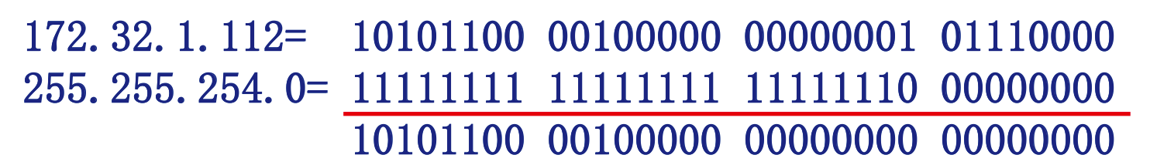
子网掩码使用-举例
MOOC 4.3.5 大约14’20”处
目的IP地址:172.32.1.112，子网掩码:255.255.254.0
求出：目的IP所在的子网地址、可分配的地址范围
子网地址
地址范围
可分配地址范围
172.32.0.0（子网掩码:255.255.254.0）
172.32.0.0 ~ 172.32.1.255
172.32.0.1 ~ 172.32.1.254

Slide 98
MOOC 4.3.5 大约14’20”处

Slide 99
IP addressing: CIDR
CIDR: Classless InterDomain Routing
  subnet portion of address of arbitrary length
  address format: a.b.c.d/x, where x is # bits in subnet portion of address
subnet
part
host
part
11001000 00010111 00010000 00000000
提高IPv4 地址空间分配效率
提高路由效率
  将多个子网聚合为一个较大的子网
  构造超网(supernetting)
200.23.16.0/23

Slide 100
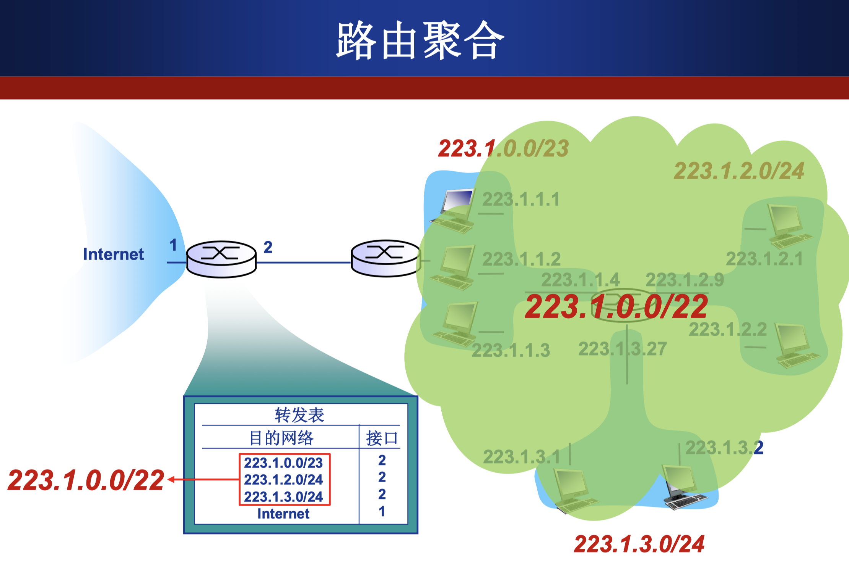
IP addressing: CIDR

Slide 101
IP addresses: how to get one?
Q: How does a host get IP address?
hard-coded by system admin in a file
  Windows: control-panel->network->configuration->tcp/ip->properties
  UNIX: /etc/rc.config
DHCP: Dynamic Host Configuration Protocol: dynamically get address from as server
  “plug-and-play”

Slide 102
DHCP: Dynamic Host Configuration Protocol
goal: allow host to dynamically obtain its IP address from network server when it joins network
  can renew its lease on address in use
  allows reuse of addresses (only hold address while connected/“on”)
  support for mobile users who want to join network (more shortly)
DHCP overview:
  host broadcasts “DHCP discover” msg [optional]
  DHCP server responds with “DHCP offer” msg [optional]
  host requests IP address: “DHCP request” msg
  DHCP server sends address: “DHCP ack” msg

Slide 103


DHCP client-server scenario
DHCP
server
223.1.1.0/24
223.1.1.1
223.1.2.1
223.1.1.2
arriving DHCP
client needs
address in this
network
223.1.1.4
223.1.2.9
223.1.3.27
223.1.2.2
223.1.1.3
223.1.2.0/24
223.1.3.1
223.1.3.2
223.1.3.0/24

Slide 104
DHCP client-server scenario
DHCP server: 223.1.2.5
DHCP discover
arriving
client
src : 0.0.0.0, 68
dest.: 255.255.255.255,67
yiaddr: 0.0.0.0
transaction ID: 654
Broadcast: is there a DHCP server out there?
DHCP offer
src: 223.1.2.5, 67
dest: 255.255.255.255, 68
yiaddrr: 223.1.2.4
transaction ID: 654
lifetime: 3600 secs
Broadcast: I’m a DHCP server! Here’s an IP address you can use
DHCP request
src: 0.0.0.0, 68
dest:: 255.255.255.255, 67
yiaddrr: 223.1.2.4
transaction ID: 655
lifetime: 3600 secs
Broadcast: OK. I’ll take that IP address!
DHCP ACK
src: 223.1.2.5, 67
dest: 255.255.255.255, 68
yiaddrr: 223.1.2.4
transaction ID: 655
lifetime: 3600 secs
Broadcast: OK. You’ve got that IP address!

Slide 105
DHCP: more than IP addresses
DHCP can return more than just allocated IP address on subnet:
  address of first-hop router for client
  name and IP address of DNS sever
  network mask (indicating network versus host portion of address)

Slide 106


DHCP: example
connecting laptop needs its IP address, addr of first-hop router, addr of DNS server: use DHCP
DHCP
DHCP
UDP
IP
Eth
Phy
DHCP
DHCP
DHCP
DHCP request encapsulated in UDP, encapsulated in IP, encapsulated in 802.1 Ethernet
DHCP
DHCP
DHCP
UDP
IP
Eth
Phy
168.1.1.1
DHCP
DHCP
DHCP
DHCP
router with DHCP
server built into
router
Ethernet frame broadcast (dest: FFFFFFFFFFFF) on LAN, received at router running DHCP server
Ethernet demuxed to IP demuxed, UDP demuxed to DHCP

Slide 107
DHCP: example
DCP server formulates DHCP ACK containing client’s IP address, IP address of first-hop router for client, name & IP address of DNS server
DHCP
DHCP
UDP
IP
Eth
Phy
DHCP
DHCP
DHCP
encapsulation of DHCP server, frame forwarded to client, demuxing up to DHCP at client
DHCP
DHCP
UDP
IP
Eth
Phy
DHCP
DHCP
DHCP
router with DHCP
server built into
router
DHCP
client now knows its IP address, name and IP address of DSN server, IP address of its first-hop router

Slide 108
DHCP: Wireshark output (home LAN)
reply
Message type: Boot Reply (2)
Hardware type: Ethernet
Hardware address length: 6
Hops: 0
Transaction ID: 0x6b3a11b7
Seconds elapsed: 0
Bootp flags: 0x0000 (Unicast)
Client IP address: 192.168.1.101 (192.168.1.101)
Your (client) IP address: 0.0.0.0 (0.0.0.0)
Next server IP address: 192.168.1.1 (192.168.1.1)
Relay agent IP address: 0.0.0.0 (0.0.0.0)
Client MAC address: Wistron_23:68:8a (00:16:d3:23:68:8a)
Server host name not given
Boot file name not given
Magic cookie: (OK)
Option: (t=53,l=1) DHCP Message Type = DHCP ACK
Option: (t=54,l=4) Server Identifier = 192.168.1.1
Option: (t=1,l=4) Subnet Mask = 255.255.255.0
Option: (t=3,l=4) Router = 192.168.1.1
Option: (6) Domain Name Server
Length: 12; Value: 445747E2445749F244574092;
IP Address: 68.87.71.226;
IP Address: 68.87.73.242;
IP Address: 68.87.64.146
Option: (t=15,l=20) Domain Name = "hsd1.ma.comcast.net."
Message type: Boot Request (1)
Hardware type: Ethernet
Hardware address length: 6
Hops: 0
Transaction ID: 0x6b3a11b7
Seconds elapsed: 0
Bootp flags: 0x0000 (Unicast)
Client IP address: 0.0.0.0 (0.0.0.0)
Your (client) IP address: 0.0.0.0 (0.0.0.0)
Next server IP address: 0.0.0.0 (0.0.0.0)
Relay agent IP address: 0.0.0.0 (0.0.0.0)
Client MAC address: Wistron_23:68:8a (00:16:d3:23:68:8a)
Server host name not given
Boot file name not given
Magic cookie: (OK)
Option: (t=53,l=1) DHCP Message Type = DHCP Request
Option: (61) Client identifier
Length: 7; Value: 010016D323688A;
Hardware type: Ethernet
Client MAC address: Wistron_23:68:8a (00:16:d3:23:68:8a)
Option: (t=50,l=4) Requested IP Address = 192.168.1.101
Option: (t=12,l=5) Host Name = "nomad"
Option: (55) Parameter Request List
Length: 11; Value: 010F03062C2E2F1F21F92B
1 = Subnet Mask; 15 = Domain Name
3 = Router; 6 = Domain Name Server
44 = NetBIOS over TCP/IP Name Server
……
request

Slide 109
IP addresses: how to get one?
Q: how does network get subnet part of IP addr?
A: gets allocated portion of its provider ISP’s address space
ISP's block 11001000 00010111 00010000 00000000 200.23.16.0/20
Organization 0 11001000 00010111 00010000 00000000 200.23.16.0/23
Organization 1 11001000 00010111 00010010 00000000 200.23.18.0/23
Organization 2 11001000 00010111 00010100 00000000 200.23.20.0/23
... ….. …. ….
Organization 7 11001000 00010111 00011110 00000000 200.23.30.0/23

Slide 110
Hierarchical addressing: route aggregation
hierarchical addressing allows efficient advertisement of routing information:
Organization 0
200.23.16.0/23
Organization 1
200.23.18.0/23
“Send me anything
with addresses
beginning
200.23.16.0/20”
Organization 2
200.23.20.0/23
.
Fly-By-Night-ISP
.
.
.
.
Internet
Organization 7
.
200.23.30.0/23
ISPs-R-Us
“Send me anything
with addresses
beginning
199.31.0.0/16”

Slide 111
Hierarchical addressing: more specific routes
ISPs-R-Us has a more specific route to Organization 1
Organization 0
200.23.16.0/23
“Send me anything
with addresses
beginning
200.23.16.0/20”
Organization 2
200.23.20.0/23
.
Fly-By-Night-ISP
.
.
.
.
Internet
Organization 7
.
200.23.30.0/23
ISPs-R-Us
“Send me anything
with addresses
beginning 199.31.0.0/16
or 200.23.18.0/23”
Organization 1
200.23.18.0/23

Slide 112
IP addressing: the last word...
Q: how does an ISP get block of addresses?
A: ICANN: Internet Corporation for Assigned
Names and Numbers http://www.icann.org/
  allocates addresses
  manages DNS
  assigns domain names, resolves disputes

Slide 113
NAT: network address translation
rest of
Internet
local network
(e.g., home network)
10.0.0/24
10.0.0.1
10.0.0.4
10.0.0.2
138.76.29.7
10.0.0.3
all datagrams leaving local
network have same single source NAT IP address: 138.76.29.7,different source port numbers
datagrams with source or
destination in this network
have 10.0.0/24 address for
source, destination (as usual)

Slide 114
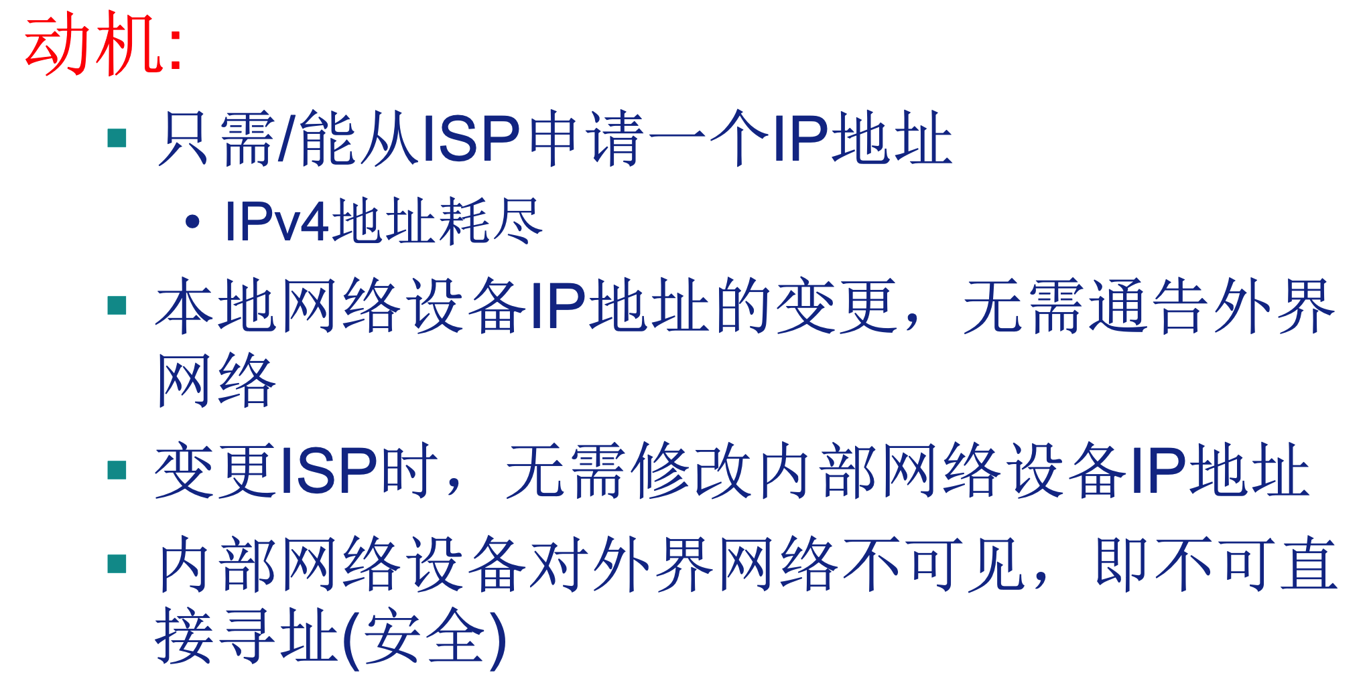
NAT: network address translation
motivation: local network uses just one IP address as far as outside world is concerned:
  range of addresses not needed from ISP: just one IP address for all devices
  can change addresses of devices in local network without notifying outside world
  can change ISP without changing addresses of devices in local network
  devices inside local net not explicitly addressable, visible by outside world (a security plus)

Slide 115
NAT: network address translation
implementation: NAT router must:
  outgoing datagrams: replace (source IP address, port #) of every outgoing datagram to (NAT IP address, new port #)
    . . . remote clients/servers will respond using (NAT IP address, new port #) as destination addr
  remember (in NAT translation table) every (source IP address, port #) to (NAT IP address, new port #) translation pair
  incoming datagrams: replace (NAT IP address, new port #) in dest fields of every incoming datagram with corresponding (source IP address, port #) stored in NAT table

Slide 116
NAT: network address translation
NAT translation table
WAN side addr LAN side addr
2: NAT router
changes datagram
source addr from
10.0.0.1, 3345 to
138.76.29.7, 5001,
updates table
1: host 10.0.0.1
sends datagram to
128.119.40.186, 80
138.76.29.7, 5001 10.0.0.1, 3345
…… ……
S: 10.0.0.1, 3345
D: 128.119.40.186, 80
10.0.0.1
1
2
S: 138.76.29.7, 5001
D: 128.119.40.186, 80
10.0.0.4
10.0.0.2
138.76.29.7
S: 128.119.40.186, 80
D: 10.0.0.1, 3345
4
S: 128.119.40.186, 80
D: 138.76.29.7, 5001
3
10.0.0.3
4: NAT router
changes datagram
dest addr from
138.76.29.7, 5001 to 10.0.0.1, 3345
3: reply arrives
dest. address:
138.76.29.7, 5001
* Check out the online interactive exercises for more examples: http://gaia.cs.umass.edu/kurose_ross/interactive/

Slide 117
NAT: network address translation
16-bit port-number field:
  60,000 simultaneous connections with a single LAN-side address!
NAT is controversial: 有争议的
  routers should only process up to layer 3
  address shortage should be solved by IPv6
  violates end-to-end argument
    NAT possibility must be taken into account by app designers, e.g., P2P applications
  NAT traversal: what if client wants to connect to server behind NAT?
NAT穿透：MOOC 4.6 16’20”

Slide 118
Chapter 4: outline
4.1 Overview of Network layer
  data plane
  control plane
4.2 What’s inside a router
4.3 IP: Internet Protocol
  datagram format
  fragmentation
  IPv4 addressing
  network address translation
  IPv6
4.4 Generalized Forward and SDN
  match
  action
  OpenFlow examples of match-plus-action in action

Slide 119
IPv6: motivation
initial motivation: 32-bit address space soon to be completely allocated.
additional motivation:
  header format helps speed processing/forwarding
  header changes to facilitate QoS
IPv6 datagram format:
  fixed-length 40 byte header
  no fragmentation allowed

Slide 120
IPv6 datagram format
priority: identify priority among datagrams in flow
flow Label: identify datagrams in same “flow.”
(concept of“flow” not well defined).
next header: identify upper layer protocol for data
ver
pri
flow label
payload len
next hdr
hop limit
source address
(128 bits)
destination address
(128 bits)
data
32 bits

Slide 121
Other changes from IPv4
checksum: removed entirely to reduce processing time at each hop
options: allowed, but outside of header, indicated by “Next Header” field
ICMPv6: new version of ICMP
  additional message types, e.g. “Packet Too Big”
  multicast group management functions
IPv6地址表达形式：MOOC 4.8 11’48”-19’12”

Slide 122
Transition from IPv4 to IPv6
not all routers can be upgraded simultaneously
  no “flag days”
  how will network operate with mixed IPv4 and IPv6 routers?
tunneling: IPv6 datagram carried as payload in IPv4 datagram among IPv4 routers
IPv4 header fields
IPv6 header fields
IPv4 payload
IPv4 source, dest addr
IPv6 source dest addr
UDP/TCP payload
IPv6 datagram
IPv4 datagram

Slide 123
Tunneling
A
B
IPv4 tunnel
connecting IPv6 routers
E
F
logical view:
IPv6
IPv6
IPv6
IPv6
A
B
C
D
E
F
physical view:
IPv6
IPv6
IPv4
IPv4
IPv6
IPv6

Slide 124
Tunneling
A
B
IPv4 tunnel
connecting IPv6 routers
E
F
logical view:
IPv6
IPv6
IPv6
IPv6
A
B
C
D
E
F
physical view:
IPv6
IPv6
IPv4
IPv4
IPv6
IPv6
flow: X
src: A
dest: F
data
src:B
dest: E
src:B
dest: E
flow: X
src: A
dest: F
data
Flow: X
Src: A
Dest: F
data
Flow: X
Src: A
Dest: F
data
A-to-B:
IPv6
B-to-C:
IPv6 inside
IPv4
B-to-C:
IPv6 inside
IPv4
E-to-F:
IPv6

Slide 125
IPv6: adoption
一方面：改变网络层协议是非常困难的
自20世纪90年代初以来，许多新的网络层协议被吹捧为互联网的下一个主要革命，但迄今为止，大多数这些协议的渗透率有限，包括IPv6、多播协议和资源预留协议。
在网络层引入新协议就像更换房子的地基——如果不拆掉整个房子，或者至少暂时重新安置房子里的居民，就很难做到这一点。
另一方面：引入新的应用层协议相对容易，就像给房子添上一层新的油漆。
互联网见证了应用层新协议的快速部署，例如：即时通讯、流媒体、分布式游戏和各种形式的社交媒体。
在未来，期待看到互联网网络层的变化，但这些变化可能会在一个时间尺度上发生，比在应用层发生的变化要慢得多。
Google: 8% of clients access services via IPv6
NIST: 1/3 of all US government domains are IPv6 capable
Long (long!) time for deployment, use
  20 years and counting!
  think of application-level changes in last 20 years: WWW, Facebook, streaming media, Skype, …
  Why?

Slide 126
Chapter 4: outline
4.1 Overview of Network layer
  data plane
  control plane
4.2 What’s inside a router
4.3 IP: Internet Protocol
  datagram format
  fragmentation
  IPv4 addressing
  network address translation
  IPv6
4.4 Generalized Forward and SDN
  match
  action
  OpenFlow examples of match-plus-action in action

Slide 127
Logically centralized control plane
A distinct (typically remote) controller interacts with local control agents (CAs)
Remote Controller
control
plane
data
plane
CA
CA
CA
CA
CA
values in arriving
packet header
0111
1
3
2

Slide 128
路由选择算法决定转发表中的值
远程控制器确定并分发转发表中的值

Slide 129
Generalized Forwarding and SDN
Each router contains a flow table that is computed and distributed by a logically centralized routing controller
logically-centralized routing controller
control plane
data plane
local flow table
headers counters actions
1
0100 1101
3
2
values in arriving
packet’s header

Slide 130
OpenFlow data plane abstraction
flow: defined by header fields
generalized forwarding: simple packet-handling rules
  Pattern: match values in packet header fields
  Actions: for matched packet: drop, forward, modify, matched packet or send matched packet to controller
  Priority: disambiguate overlapping patterns
  Counters: #bytes and #packets
Flow table in a router (computed and distributed by controller) define router’s match+action rules

Slide 131
OpenFlow data plane abstraction
flow: defined by header fields
generalized forwarding: simple packet-handling rules
  Pattern: match values in packet header fields
  Actions: for matched packet: drop, forward, modify, matched packet or send matched packet to controller
  Priority: disambiguate overlapping patterns
  Counters: #bytes and #packets
* : wildcard
src=1.2.*.*, dest=3.4.5.* → drop
src = *.*.*.*, dest=3.4.*.* → forward(2)
3. src=10.1.2.3, dest=*.*.*.* → send to controller

Slide 132
OpenFlow: Flow Table Entries
Rule
Action
Stats
Packet + byte counters
Forward packet to port(s)
Encapsulate and forward to controller
Drop packet
Send to normal processing pipeline
Modify Fields
Switch
Port
VLAN
ID
MAC
src
MAC
dst
Eth
type
IP
Src
IP
Dst
IP
Prot
TCP
sport
TCP
dport
Link layer
Network layer
Transport layer
Notes:
Now I’ll describe the API that tries to meet these goals.
132

Slide 133
Examples
Destination-based forwarding:
Switch
Port
MAC
src
MAC
dst
Eth
type
VLAN
ID
IP
Src
IP
Dst
IP
Prot
TCP
sport
TCP
dport
Action
*
*
*
*
*
*
51.6.0.8
*
*
*
port6
IP datagrams destined to IP address 51.6.0.8 should be forwarded to router output port 6
Firewall:
Switch
Port
MAC
src
MAC
dst
Eth
type
VLAN
ID
IP
Src
IP
Dst
IP
Prot
TCP
sport
TCP
dport
Forward
*
*
*
*
*
*
*
*
*
22
drop
do not forward (block) all datagrams destined to TCP port 22
Switch
Port
MAC
src
MAC
dst
Eth
type
VLAN
ID
IP
Src
IP
Dst
IP
Prot
TCP
sport
TCP
dport
Forward
*
*
*
*
*
128.119.1.1
*
*
*
*
drop
do not forward (block) all datagrams sent by host 128.119.1.1

Slide 134
Examples
Destination-based layer 2 (switch) forwarding:
Switch
Port
MAC
src
MAC
dst
Eth
type
VLAN
ID
IP
Src
IP
Dst
IP
Prot
TCP
sport
TCP
dport
Action
*
22:A7:23:
11:E1:02
*
*
*
*
*
*
*
*
port3
layer 2 frames from MAC address 22:A7:23:11:E1:02 should be forwarded to output port 6

Slide 135
OpenFlow abstraction
match+action: unifies different kinds of devices
Router
  match: longest destination IP prefix
  action: forward out a link
Switch
  match: destination MAC address
  action: forward or flood
Firewall
  match: IP addresses and TCP/UDP port numbers
  action: permit or deny
NAT
  match: IP address and port
  action: rewrite address and port

Slide 136


OpenFlow example
Example: datagrams from hosts h5 and h6 should be sent to h3 or h4, via s1 and from there to s2
match
action
IP Src = 10.3.*.*
IP Dst = 10.2.*.*
forward(3)
Host h6
10.3.0.6
1
s3
controller
2
3
4
Host h5
10.3.0.5
1
s1
s2
1
2
Host h4
10.2.0.4
4
2
4
Host h1
10.1.0.1
3
3
Host h2
10.1.0.2
match
action
match
action
Host h3
10.2.0.3
ingress port = 2
IP Dst = 10.2.0.3
ingress port = 2
IP Dst = 10.2.0.4
forward(3)
ingress port = 1
IP Src = 10.3.*.*
IP Dst = 10.2.*.*
forward(4)
forward(4)

Slide 137
Chapter 4: done!
4.1 Overview of Network layer: data plane and control plane
4.2 What’s inside a router
4.3 IP: Internet Protocol
  datagram format
  fragmentation
  IPv4 addressing
  NAT
  IPv6
4.4 Generalized Forward and SDN
  match plus action
  OpenFlow example
Question: how do forwarding tables (destination-based forwarding) or flow tables (generalized forwarding) computed?
Answer: by the control plane (next chapter)

